Slide 1
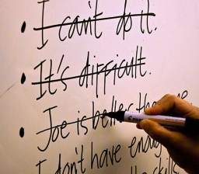
Defense Mechanisms

Slide 2
Defense Mechanisms
Defense mechanisms are behaviors that an individual might use to cope with an uncomfortable situation or problem.

Slide 3
Compensation
A person tries to make up for his/ her weaknesses by developing strengths in other areas.
Example – A struggling student with a learning disability becomes a leader in the art club.
Harmful – Not trying to overcome the weakness.

Slide 4
Daydreaming
A person escapes unpleasant, boring, or frustrating situations by imagining that he or she is doing something else.
Example – A shy student imagines that he/she is homecoming king/queen.
Harmful – Refusal to accept reality and spending too much time in an imaginary world.

Slide 5
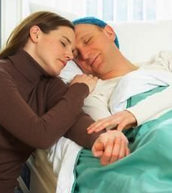
Denial
Refusal to accept reality.
Example – A student finds out that a relative has a terminal disease. The student continues to act as though the relative is going to live.
Harmful – Continual inability to accept a situation long after it has occurred.

Slide 6
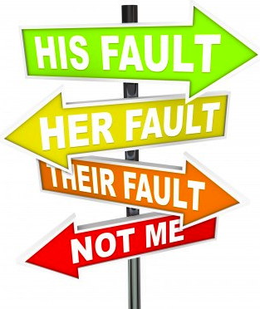
Displacement
A person transfers the emotions he or she feels from the original situation or object to another situation or object.
Example – A student is angry with a parent but yells at his/her brother or sister.
Harmful – Continuously taking anger out on an innocent person.

Slide 7
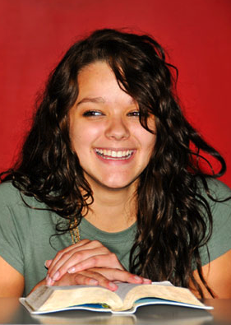
Humor
A person focuses on the funny aspects of a painful situation.
Example - A person is called a bad name and then refers to himself by that name to deflect the teasing.
Harmful – Person is accepting a social injustice. Name-calling should not be tolerated.

Slide 8
Identification
A person tries to assume the qualities of someone that is admired.
Example - A students wants to be like a famous person so they begin to dress and act like that person.
Harmful – Measuring own worth to someone else’s standards instead of developing one’s own strengths.

Slide 9
Projection
A person shifts the blame and/or responsibility for his/her actions or thoughts to another person.
Example – A student does poorly on a test and says that the teacher wrote an unfair test.
Harmful – Refusal to accept responsibility for actions.

Slide 10
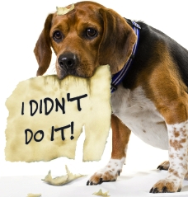
Rationalization
An attempt to justify one’s actions with an excuse rather than by admitting one’s failure or mistake.
Example – A student justifies flunking a test because he/she was absent the day it was scheduled. [Or, the dog ate his homework!]
Harmful - Refusal to accept responsibility for actions.

Slide 11
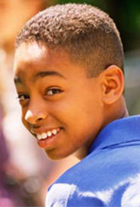
Regression
Retreating to an earlier time that seems less threatening and requires less responsibility.
Example – A student has trouble fitting in at middle school so he/she returns and visits their elementary school, thinking that it would be nice to stay there.
Harmful – Refusal to move on and mature within a reasonable amount of time.

Slide 12
Repression
Blocking out thoughts about unpleasant things or experiences. Repression is actually an unconscious method of escaping something unpleasant.
Example – A woman is raped, she pushes the thought out of her mind, she doesn’t even think it happened.
Harmful – Inability to recognize what has happened, especially if she needs to receive help.

Slide 13
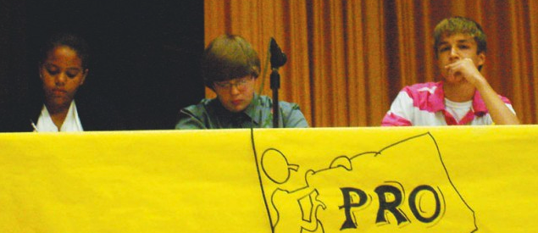
Sublimation
Transforming unacceptable behaviors into acceptable ones. Sublimation can involve redirecting specific behaviors.
Example – A student likes to get into arguments, so he/she decides to join the debate team.
Harmful – Inability to recognize the need to change unacceptable behaviors into acceptable ones.

Slide 14
Suppression
The effort to hide and control unacceptable thoughts and feelings.
Example – A student is attracted to someone, but he/she says that they do not like the person at all.
Harmful – Inability to let true feeling show.

