Slide 1
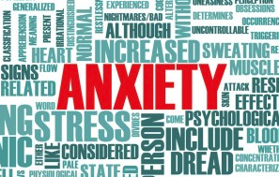
Coping with Anxiety

Slide 2
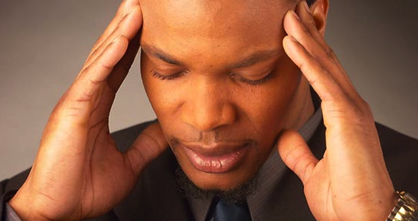
Two Sides of Anxiety
Anxiety itself is neither helpful nor hurtful. It’s your response to anxiety that is helpful or hurtful.
Sally Winston, Anxiety & Stress Disorders Institute

Slide 3
Two Sides of Anxiety
Before I go on, I’m a nervous wreck. But I feel more comfortable being uncomfortable.
Richard Lewis, Comedian

Slide 4
Two Sides of Anxiety
In the right amounts, the hormones that drive anxiety can be powerful stimulants, arousing the senses to function at their sharpest.
Alice Park, Time Magazine

Slide 5
How Anxiety Affects the Body and Brain
Immune system?
Breathing?
Cognition?
Digestion?
Emotion?
Skin?
Heart?
Metbolism?
Pain?

Slide 6
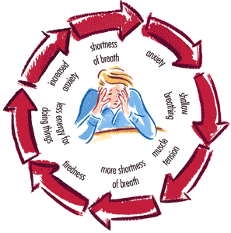
Definition of Anxiety
An emotional state in which people feel uneasy, apprehensive, or fearful. People usually experience anxiety about events they cannot control or predict, or about events that seem threatening or dangerous. There is a feeling of vulnerability, and severe anxiety can persist and become disabling.
Ronald Kulich, Tufts University

Slide 7
Effective Coping
Change negative thoughts to positive:
“I can’t handle this.”
Becomes . . .
“I can do this.”

Slide 8
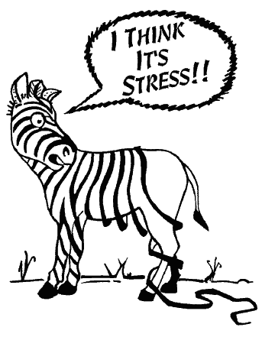
Effective Coping
See the humor in a stressful situation.

Slide 9
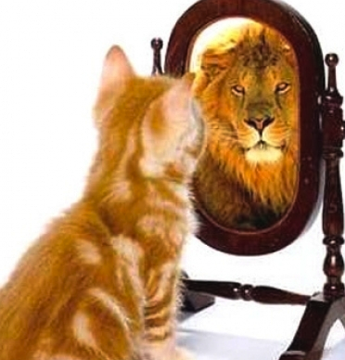
Effective Coping
Fake it till you make it. Pretend to have more confidence than you do. No one else will know the difference.

Slide 10
Effective Coping
Take care of yourself:
Eat nutrient-dense foods.
Exercise.
Avoid alcohol, tobacco, drugs.
Practice good hygiene.
Get adequate sleep.

Slide 11
Effective Coping
Rely on your support system:
Parents, family
Friends
Teachers
Counselors
Faith leader

Slide 12
Effective Coping
Stick to your routine:
Keep a planner and “to do” list.
Take one step at a time.
Check off tasks as completed.

Slide 13
Effective Coping
Just Do It!
Take one step at a time and “git ‘er done!”

Slide 14
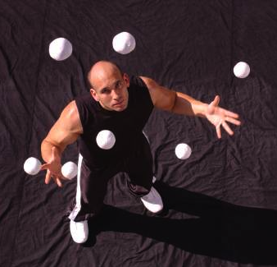
What NOT to Do to Cope with Anxiety

Slide 15
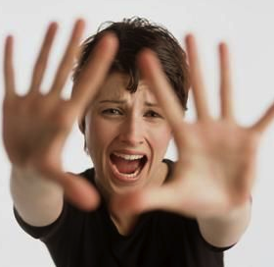
If Anxiety is Serious, Get Help!

