Slide 1
ANTI-TOBACCO advertisement

Slide 2
Essential Standard 8.ATOD.1 Analyze influences related to alcohol, tobacco, and other drug use and avoidance.

Slide 3
Clarifying Objective 8.ATOD.1.2 Predict the potential effect of anti-tobacco messages on the use of tobacco by youth and adults.

Slide 4
Anti-Tobacco Ads
Anti-tobacco ads help consumers change the way they view tobacco use.
Effective anti-tobacco ads help viewers understand the deceptive techniques used by the tobacco industry which encourages people to begin and continue tobacco use.

Slide 5
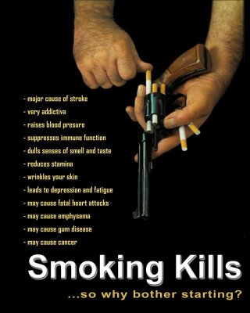
Anti-Tobacco Ads
Research on the effectiveness of anti-tobacco ads has suggested that higher anti-tobacco advertisement exposure was significantly associated with decreased odds of current smoking for all viewers.
More anti-tobacco ads = Less people smoking

Slide 7
How Are Students Affected?
Exposure to anti-smoking ads also affected middle and high school students’ attitudes and beliefs about smoking.
Students exposed to anti-tobacco campaigns had
decreased perceptions that most or all of their friends smoked
stronger five-year intentions to not smoke
a better understanding of the harm of smoking.

Slide 8
Anti-tobacco ads and campaigns can be found at the following links:
http://www.thetruth.com
http://www.realityunfiltered.com
http://thedesigninspiration.com/articles/top-45-creative-anti-smoking-advertisements
http://www.notobacco.org/photos/index.htm

Slide 9
Create Your Own Anti-Tobacco AD
What are the negative affects of tobacco products? Use those facts to create your own Anti-Tobacco Advertisement .
Examples
Comic Strip
Poster/Artwork
Script (commercial)
Poem/Short Story
Lyrics/Song/Rap

