Slide 1
Essential Standard 7.ATOD.2 Apply risk reduction behaviors to protect self and others from alcohol, tobacco, and other drug use.

Slide 2
Clarifying Objective 7.ATOD.2.2 Design methods of avoiding the consequences of tobacco, including addiction, by seeking resources for prevention and cessation.

Slide 3
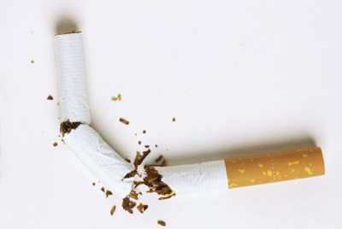
Avoiding and Overcoming Tobacco Addiction

Slide 4
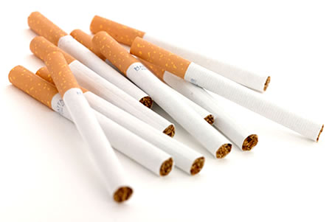
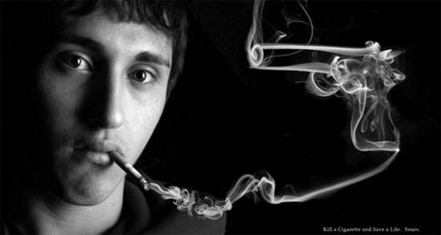
Nicotine
Nicotine is an addictive drug found in all tobacco products.
Individuals can avoid any addiction-related problems by simply opting not to use any type of tobacco product.

Slide 5
How to Avoid Nicotine
Listing all of the reasons why they do not want to use tobacco can help students recognize the risks associated with tobacco and provide a foundation for refusing tobacco.
Health behavior contracts, which include no tobacco use, are helpful when avoiding negative effects caused by nicotine.

Slide 6
Nicotine Addiction
People who regularly use tobacco products develop a tolerance to nicotine and may use more to feel the intended effects creating nicotine addiction.
Tobacco users addicted to nicotine must go through withdrawal symptoms in order to quit using tobacco.
The body begins to immediately repair itself once a person stops using tobacco; however, quitting takes planning and effort.

Slide 7
Steps to Overcome Nicotine Addiction
There are many resources that can be accessed when quitting tobacco.
Physicians and other medical providers can
help develop a plan for quitting
provide cessation counseling
prescribe a low-dose nicotine patch or chewing gum to help people cope with cravings for nicotine as they withdraw from the drug.
Users will gradually eliminate the need for nicotine and all tobacco products.

Slide 8
Quit Programs
Tobacco cessation programs can help people stop using tobacco and stay quit.
Quitline NC http://www.quitlinenc.com/ or 1-800-QUIT-NOW (1-800-784-8669) offers free expert support to those trying to quit.
A web coach is available to those 13 and older and interested in accessing a web-based cessation program offered through QuitlineNC.

