Slide 1
ADVERTIZING STRATEGIES

Slide 2
Essential Standard 6.ATOD.1 Analyze influences that the use alcohol, tobacco, and other drugs.

Slide 3
Clarifying Objective 6.ATOD.1.1 Analyze the marketing and advertising by alcohol and tobacco companies in terms of strategies used to influence youth experimentation with their products.

Slide 4
Advertizing Strategies Used When Selling Alcohol & Tobacco
6th Grade Healthful Living

Slide 5
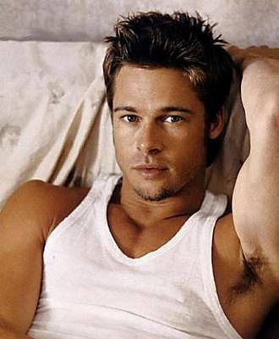
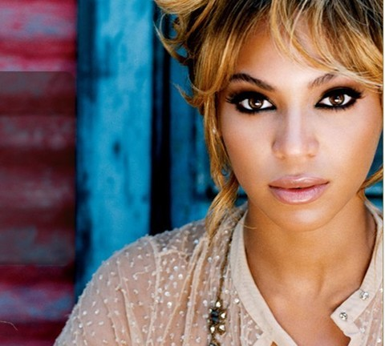
Advertizing Strategies
Bandwagon Appeal – Creates the impression that everyone is using a particular product and because everyone else is using it, you should, too.
Attractive Appeal – Implies that one will become more desirable and attractive by using the product. Often shows very attractive male and female models.

Slide 6
Advertizing Strategies
Gender Appeal – Claims that a product will make one more masculine or feminine.
Problem Solving Appeal – Suggests that using the product will make problems go away.

Slide 7
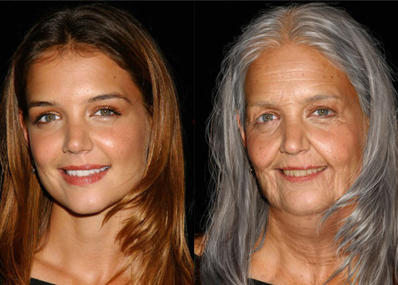
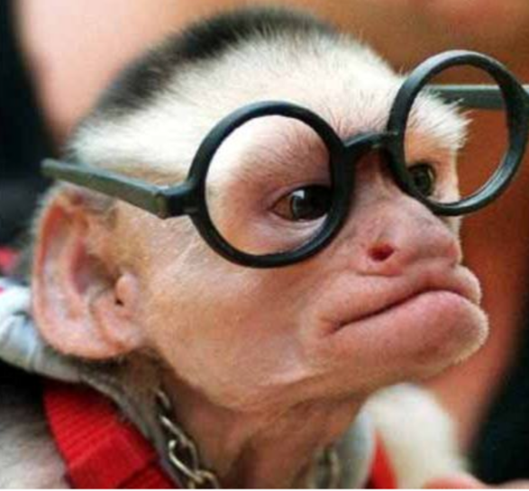
Advertizing Strategies
Youthfulness Appeal – Hints that it will stop aging or restore energy.
Sophistication Appeal – Intends to show that if you buy a certain product you will be more grown-up, independent, and mature.

Slide 8
Advertizing Strategies
Popularity Appeal – Recommends that you buy a certain product to be well liked, accepted, and part of the “in” crowd.
Fun/Relaxation Appeal – Shows that a product will make you have more fun or feel more relaxed.

Slide 9
Advertizing Strategies
Health Appeal – Implies that people shown using the product are healthy and active.
Slogans and Symbols – Use of a simple and easy to remember symbol or slogan. Slogans are set to music and have catchy tunes and words.
Examples: Symbol = Nike Swoosh, Slogan = Just Do It.

Slide 10
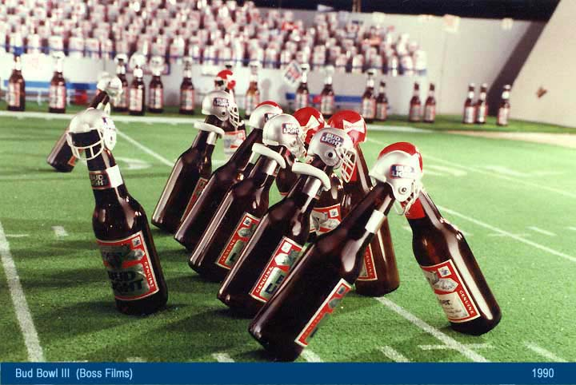
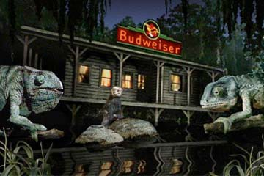
Advertizing Strategies
Animation – An inanimate object comes to life and is given a personality. Ex: Budweiser bottles playing football.
Comedy Appeal – Uses humorous slogans, jingles, and symbols.

Slide 11
Advertizing Strategies
Group Identification Appeal – Implies that members of a specific group use the product. Advertisements are targeted to groups based on age, race, religion, education, occupation, sex, money, and area they live in.
Normalization Appeal – Presents the product as a typical and acceptable part of social gatherings or as used by most people.

