Slide 1
Mental Disorders & Resources for Help
7.MEH.3.1

Slide 2
Jacob
Jacob is part of the local all-star baseball team. He just finished a long practice and decided to go to the batting cages for a few more rounds of batting practice. Just as he started really hitting the ball well, he felt something snap in his right shoulder. His right arm and his hand went numb and when he tried to lift his arm he felt excruciating pain. It was impossible to continue practicing, it was hard to drive home, he could not eat or sleep because he was in so much pain.

Slide 3
What are the signs and symptoms that Jacob has a problem?
He felt something snap in his right shoulder
His right arm and his hand went numb
When he tried to lift his arm he felt excruciating pain.
It was impossible to continue practicing, it was hard to drive home, he could not eat or sleep because he was in so much pain.

Slide 4
What Should Jacob Do?
Will Jacob most likely be able to find medical treatment for his shoulder and arm pain?
Do you think Jacob will feel ashamed to seek medical help for his shoulder and arm pain? Why or Why not?
Do you think Jacob is less of a man or less of a person if he seeks help for his shoulder or arm pain?

Slide 5
Marcus
Marcus has noticed that his moods have been changing somewhat erratically lately. For a few days he feels like he is on top of the world and nothing can stop him. He is able to do twice the work he can normally do, run longer distances without effort, and has found that he needs very little sleep at night. He has also noticed days when he sleeps for 10 hours and still finds it hard to get out of bed in the morning. When he feels tired, he also feels sad, and hopeless for many days. He has missed several occasions to hang out with his friends, he does not want to go on dates anymore, and he has missed several days of school. He used to be an avid runner but now he just cannot find the energy to finish a short run.

Slide 6
What are the signs and symptoms that Marcus has a problem?
For a few days he feels like he is on top of the world and nothing can stop him. He is able to do twice the work he can normally do, run longer distances without effort, and has found that he needs very little sleep at night.
He has days when he sleeps for 10 hours and still finds it hard to get out of bed in the morning.
When he feels tired, he also feels sad, and hopeless for many days.
He has missed several occasions to hang out with his friends, he does not want to go on dates anymore, and he has missed several days of school.
He used to be an avid runner but now he just cannot find the energy to finish a short run.

Slide 7
What Should Marcus Do?
Will Marcus most likely be able to find medical treatment for mental disorders?
Do you think Marcus will feel ashamed to seek medical help for his mental disorder? Why or Why not?
Do you think Marcus is less of a man or less of a person if he seeks help for his mental health problems?
Is there a stigma associated with seeking help for one’s mental health? If so, why?

Slide 8
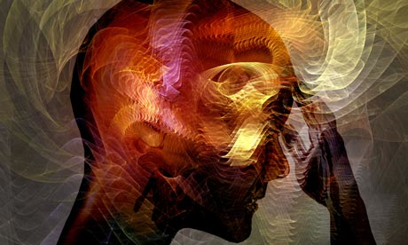
Mental Health
Mental Health is how we think, feel, and act as we cope with life. It also determines how we handle stress, relate to others, and make choices.

Slide 9
Mental Disorders
An estimated 1 in 4 adults over the age of 18 suffers from a diagnosable mental disorder.
Mental disorders are the leading cause of disability in the United States.
Many people suffer from more than one mental disorder at a given time.
Source – National Institute of Mental Health

Slide 10
Causes Associated With Mental Disorders
There are many causes of mental disorders.
Family history and genetics may play a role in the development of mental disorders.
Life experiences (stress, abuse, trauma) may be related to the development of mental disorders.
A brain injury or illness can lead to mental disorder development.

Slide 11
Treatment for Mental Disorders
Treatment depends on the particular mental disorder, the level of severity, and an individual’s life situation
Many patients see improvements when working with a team of health care providers and support systems that can include:
Family doctor
Psychiatrist (medical doctor who diagnoses and treats mental disorders)
Psychotherapist (psychologist or licensed counselor)
Pharmacists
Social workers
Family members

Slide 12
Crisis Services
Can include a 24-hour hotline for anyone experiencing a mental health crisis.
Provide crisis counseling, suicide prevention, support, information and referrals.
Provide access links to local support systems and health services if needed.
Outreach visits from professional counselors or social workers for face-to-face assessment and evaluation.

Slide 13
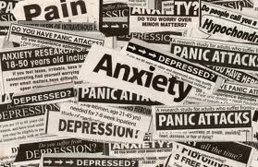
Screening and Referral
Primary care centers, hospitals, emergency rooms, trauma centers, and other community settings may provide screenings and referrals to appropriate treatment centers for those who might be experiencing signs or symptoms of a mental disorder.

Slide 14
Medication
Psychiatric medications do not “cure” a patient from a mental disorder but they can improve the symptoms.
Psychiatric medications can help make other treatments more effective.

Slide 15
Examples of Medication
Antidepressants – can improve symptoms such as sadness, hopelessness, lack of energy, difficulty concentrating and lack of interest in activities. They are grouped by how they affect brain chemistry.
Mood-stabilizing medications – most commonly used to treat bipolar disorder. Some mood-stabilizing medications are added to antidepressants to treat depression.

Slide 16
Examples of Medication
Anti-anxiety medications – treat anxiety disorders and may be useful to reduce agitation and insomnia. They are fast acting but may cause dependency.
Antipsychotic medications – used to treat psychotic disorders such as schizophrenia. They may also be used to treat bipolar disorder and depression.

Slide 17
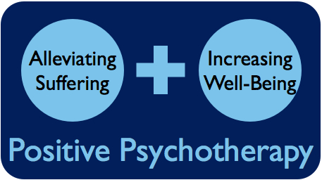
Psychotherapy
General term used to refer to the process of treating mental disorders by talking about the condition and related issues.
During psychotherapy, patients learn about the condition, their moods, thoughts, feelings, and behaviors and strategies for coping with stress and other contributing factors.

Slide 18
Psychotherapy
Therapy can be completed within a few months, yet some cases require more long-term treatment.
Therapy can take place one-on-one or in a group setting.

Slide 19
Inpatient Treatment Services
Severe cases of mental disorders may require psychiatric hospitalization.
Can be a 24-hour inpatient care, partial day hospitalization, or residential treatment offering temporary living arrangements.
Can include substance abuse treatment (counseling, medications, support groups)

Slide 20
Mental Disorder Treatment Options
There are numerous treatment options for mental disorders. Only trained professionals are capable of diagnosing mental disorders and prescribing the appropriate regimen of treatment.
The key to getting help is to recognize signs and symptoms of mental disorders and contact available resources for help without hesitation.
Once a treatment is prescribed, it is critical to follow through with the necessary steps provided in the treatment plan.

