Slide 1
Essential Standard 7.ATOD.1 Understand the health risks associated with alcohol, tobacco, and other drug use.

Slide 2
Clarifying Objective 7.ATOD.1.3 Predict consequences of abuse of over-the-counter medicines from information provided by the manufacturers of these medicines.

Slide 3
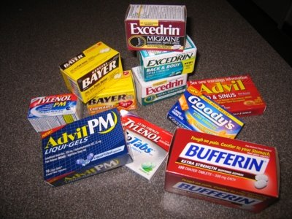
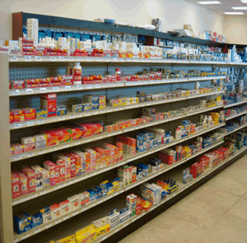
OTCs – Over The Counter Medicine

Slide 4
What are OTCs?
Over-the-counter (OTC) drugs are chemical compounds that can be bought in drugstores, grocery stores, and pharmacies without a physician’s prescription.
Many OTC drugs are intended to alleviate symptoms associated with common colds and other minor health problems such as headaches, fevers, rashes, stomach discomfort, muscle aches, sore throat, coughing.
Most of these drugs are generally safe if taken as directed by dosage recommendations on the packaging.

Slide 5
Be Cautious with OTC Use
If these drugs are overused, used in large dosages not recommended by the manufacturer, or used in combination with other drugs, health risks may occur.
Read labels carefully to be sure the dosage is correct and to make sure that ingredients in one OTC drug are not also included in any other drug that one may be taking.

Slide 6
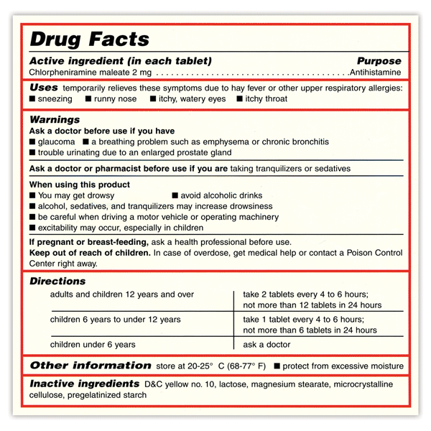
OTC Drug Labels
Over-the-counter drug labels were patterned after Nutrition Facts food labels.

Slide 7
OTC Drug Label Include
The product's active ingredients, including the amount in each dosage unit
The purpose of the product
The uses (indications) for the product
Specific warnings, including when the product should not be used under any circumstances
When it is appropriate to consult with a doctor or pharmacist.

Slide 8
OTC Drug Labels
This section also describes side effects that could occur and substances or activities to avoid, dosage instructions--when, how, and how often to take the product.
The product's inactive ingredients, important information to help consumers avoid ingredients that may cause an allergic reaction.

